Slide 1
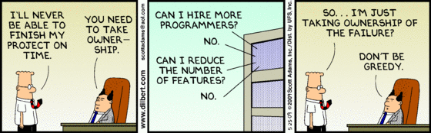
IT Schedule Negotiation
Phil Pfeiffer
Fall, 2014

Slide 2
During the past year, I [consulted] for a project that was proceeding so smoothly that the project manager knew she would deliver the project on schedule.
She was summoned in front of the management committee and asked for a progress report.
She said [she] could guarantee [her] project would be ready [for] March 1, exactly on time according to the original estimate.
The upper managers chewed over [that] unexpected good news and then called her in again the next day.
Since she was on time for March 1, they explained, the deadline had been moved up to January 15.
- - Tim Lister, Peopleware

Slide 3
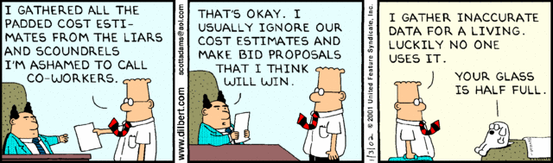
Schedule Negotiation
Classic sore point in project management
Ultimate strategy for addressing: principled negotiation (more later)
Much of software project mgmt. literature concerned with
▪ Creating awareness of why pressures exist
▪ Naming the games (intimidation; trickery)
▪ Coping with pressures

Slide 4
"Spanish Theory of Value"
▪ View that amount of wealth in a fiscal ecosystem is fixed
▪ Consequence: adversarial project scheduling
▪ Schedule by due dates, rather than effort
▪ Require overtime to complete it
▪ Ed Yourdon's term: "death march projects"
▪ Ed Yourdon: half of projects he sees
Sources:
DeMarco, Tom and Lister, Tim, Peopleware;
Yourdon, Edward, Death March: The Complete Software Developer's Guide to Surviving "Mission Impossible" Projects

Slide 5
Characteristics, Consequences
▪ Any of the following qualify
▪ Schedule compressed to less than half of rational,
perhaps due to pressures of global marketplace
▪ Staff reduced to less than half of normal, perhaps
due to irrational faith in new productivity tool
▪ Budget and resources cut by half or more,
perhaps due to downsizing or competitive bidding
▪ Technical challenges are more than double normal
▪ Risk assessment puts odds of failure at ≥ 50%
▪ Consequence: 12+ hr days, 6/7 day weeks
Sources:
DeMarco, Tom and Lister, Tim, Peopleware;
Yourdon, Edward, Death March: The Complete Software Developer's Guide to Surviving "Mission Impossible" Projects

Slide 6
Causes
▪ Politics: i.e., managerial power struggles
▪ Managerial project struggles
▪ Extra constraints added by middle management, without clients' knowledge
Reasonable to ask if a project is a sham or has been set up to fail, then listen carefully to manager's answer
▪ Naive promises by marketing, senior execs, project mgrs, and even young hackers ("who needs documentation?")
▪ Start-up environments
▪ "[I]n general, start-up organizations are understaffed, underfinanced, undermanaged, and outrageously
optimistic about their chances of success."
Yourdon, Edward, Death March: The Complete Software Developer's Guide to Surviving "Mission Impossible" Projects

Slide 7
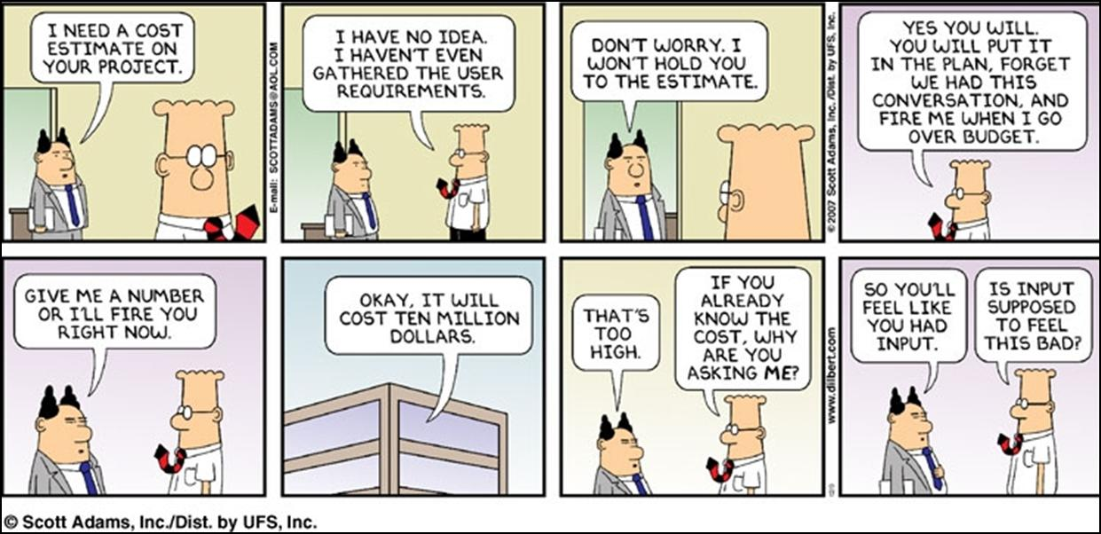

Slide 8
More Causes
▪ Marine Corps Mentality: Real programmers don't sleep!
▪ "[I]'ve seen it most often in the consulting organizations like EDS and the Big-6 accounting firms."
▪ Intense competition caused by
▪ Globalization of markets
▪ Emergence of new technologies
▪ Unexpected government regulations
▪ Unexpected and/or unplanned crises
Source:
Yourdon, Edward, Death March: The Complete Software Developer's Guide to Surviving "Mission Impossible" Projects

Slide 9
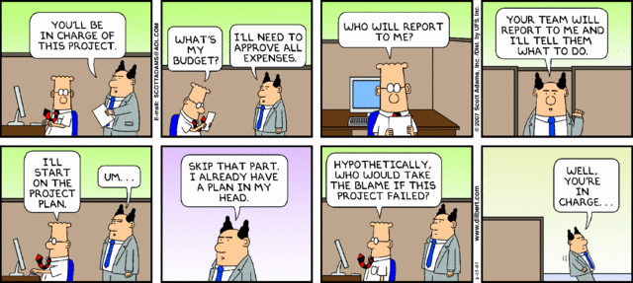

Slide 10
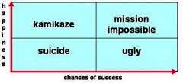
"Death March": Classification
▪ "Mission impossible": best situation
▪ "Kamikaze": "glorious failure" projects
▪ "Ugly": "Marine Corps" management, often by hired guns
▪ "Suicide": project doomed, everyone miserable
Yourdon, Edward, Death March: The Complete Software Developer's Guide to Surviving "Mission Impossible" Projects

Slide 11
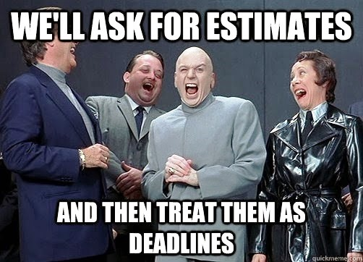
Dynamics of Ugly Projects
Standard element of ugly and suicidal projects: "management games" for getting technical people to submit to unrealistic estimates
Resources on this dynamic are fairly abundant
One favorite, Thomsett, on reading list
(http://www.thomsett.com.au/library/item/estimation-games)

Slide 12
Avoiding Death March Projects
Improve negotation skills
Why this is often needed
▪ Marketers, who negotiate against developers,
tend to be skilled negotiators
▪ Developers tend to be weak negotiators
▪ Find challenging social interactions difficult
▪ Tend to avoid negotiating tricks - e.g., highballing
Fix: principled negotiation
Source: Steve McConnell, Rapid Development

Slide 13
Improving Chances of Success
Team creation - three options
▪ Hire superstars, turn them loose
▪ Risky, due to egos; possibly impractical
▪ Use a well-honed mission impossible team
▪ Choose regular folk; alert them to issues (most common)
▪ Avoid: making an impossible team from who you have
Team management strategies
▪ Track overtime worked; avoid excesses (produces errors)
▪ Give rewards
▪ Promote team building: e.g., stress communication
▪ Rid workplace of interruptions
▪ Be ruthless with requirements triage
▪ Avoid formal processes
Yourdon, Edward, Death March: The Complete Software Developer's Guide to Surviving "Mission Impossible" Projects

Slide 14


When All Else Fails
[Resignation] is simply the rational thing to do when faced with an impossible situation, and implacable negotiating adversaries. Life will go on; there will be other projects, and other jobs.
-- Ed Yourdon
It follows that any commander in chief who undertakes to carry out a plan which he considers defective is at fault; he must put forth his reasons, insist on the plan being changed, and finally tender his resignation rather than be the instrument of his army's downfall.
-- Napoleon Bonaparte
Yourdon, Edward, Death March: The Complete Software Developer's Guide to Surviving "Mission Impossible" Projects

